Slide 1
PHP PROJECT
Efforts by :K SRIKANT IYER(RA1511003030370)
charu (ra1511003030347)
Hospital management system

Slide 2
Introduction:
System analysis:
About the existing project-:
As we all have seen that many of the hospitals follow the practice in which the patient’s information is compiled manually. The receptionists usually maintain a register where in they put the records of the patients.this results in a lot of mismanagement and confusion, which leads to delay in treatments.

Slide 3
DISADVANTAGES OF THE EXISTING SYSTEM
Information is compiled manually.
Patients data can be lost.
Patients information is usually mixed
It will be very hectic to find out the previous records of a particular patient.
A lot of mismanagement and confusion take place.

Slide 4
WHAT WE PROPOSE:
With our project we have come up with the system where we have created an online portal where all the patients information will be recorded and prescriptions are made and stored.all the basic information of the patients such as their name age occupation mobile number address,their respective doctors and the prescriptions which again consists of the details such as the medicines prescribed, dosage ,diagnosis and the instructions to be followed.

Slide 5
System specification
The following are the hardware and software requirements to create this system. As listed beow the backhand server is written in php. The data base used is sql through PDO.

Slide 6
HARDWARE REQIOREMENTS:
Pentium – IV (processor)
256 MB RAM
512 KB cache memory
Hard disk space 10 GB
Microsoft compadable 101 or more keyoard

Slide 7
SOFTWARE REQUIREMENTS
OS : Windows 10
Web Technology: Php
Front End: Html, Css
BACK END: Mysql (USING PDO)
Web Server: Apache Server

Slide 8
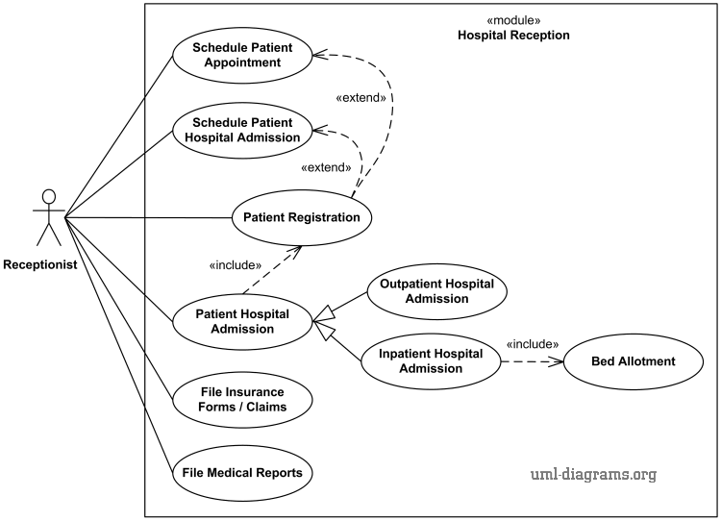
Use case diagram
diagrams

Slide 9
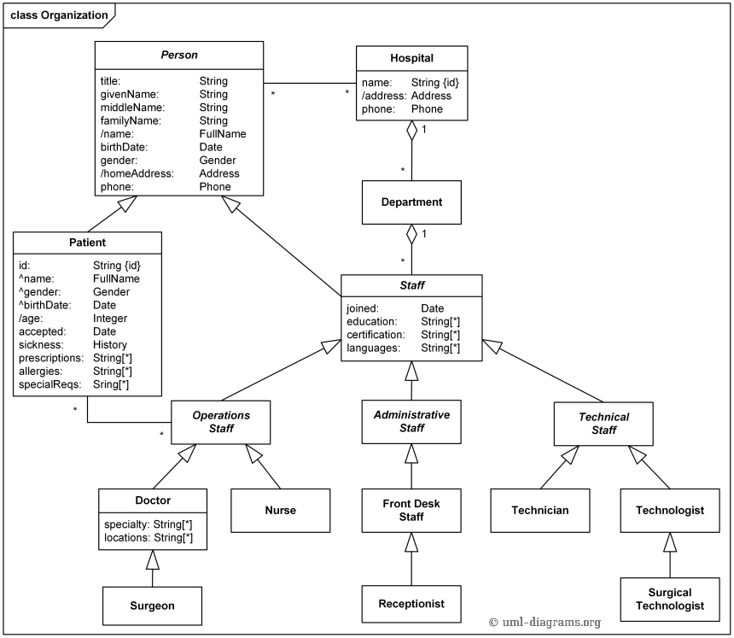
Class diagram

Slide 10
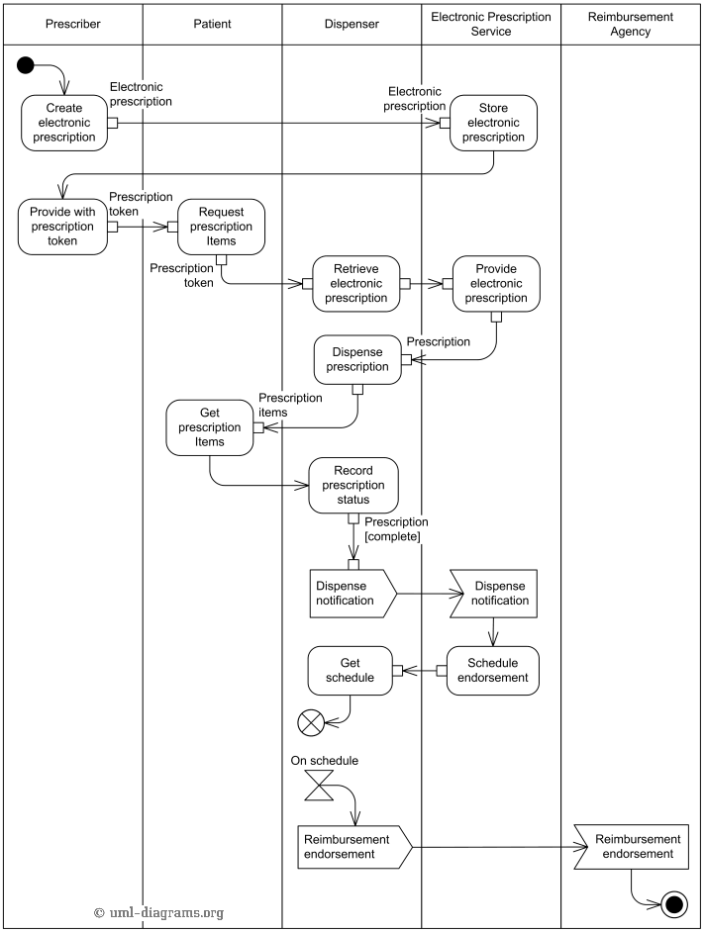
Session diagram

Slide 11
Modules included
Admin module:
The admin is the character who is able to manage the system but is unable to create prescriptions or review patients. The role of the admin is to authorise the doctor and allow to access features, the doctor or patients cant access without proper authorisation.
The admin has a unique password which is coded into the php itself and cannot be changed by the admin. We have set the password as “0000”.

Slide 12
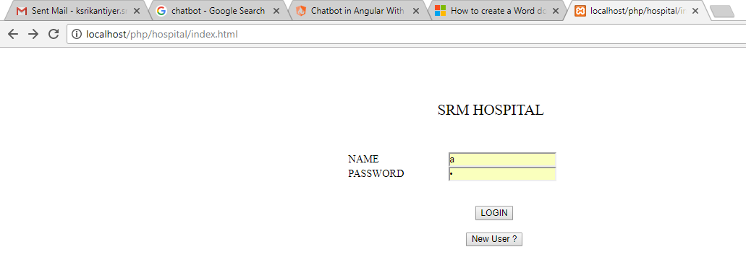
First window

Slide 13
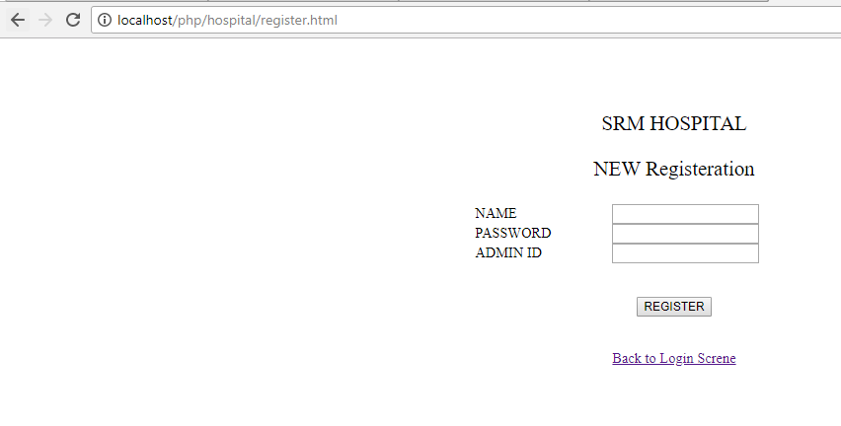
Use of admin privileges

Slide 14
Doctor login Module:
The doctors are registered with the help of the admin supervision. Once registered the doctor may use his login credentials to access the whole program. Once the doctor logs into the page, a session is stared which records what all the doctor does and which all prescription he has given.
The list of doctors is viewable by the “view doctors” button where all the doctors are shown.

Slide 15
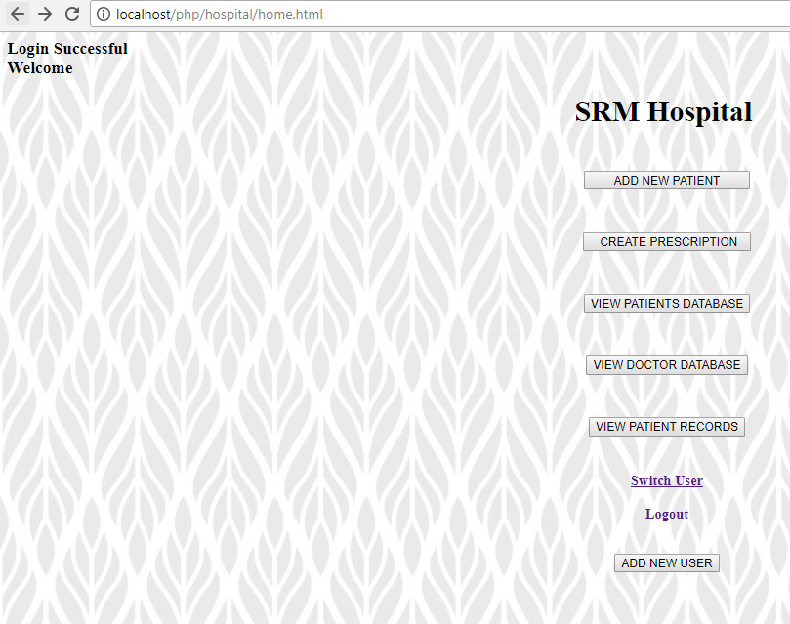
Front page

Slide 16
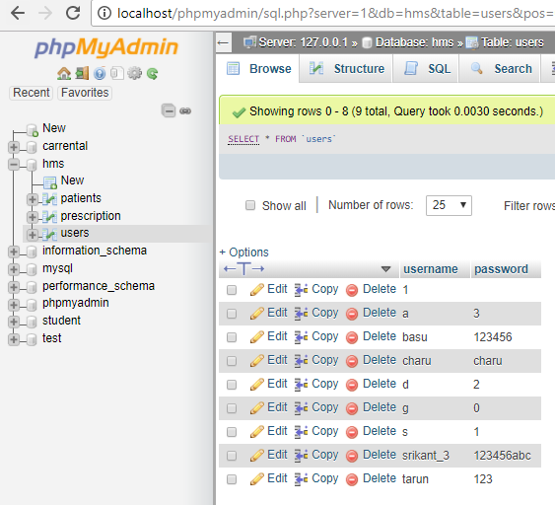
Doctor database

Slide 17
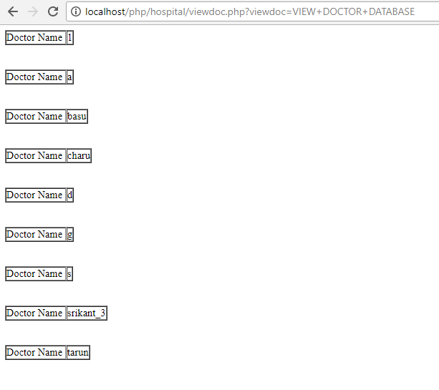
Doctor list access

Slide 18
Patient’s module:
In this module the information is stored in “Add patient’s module” where the data gets saved in the database. To view the list of patients we can access the same database and get the list of patients.
To see the history of patients we access “view patient details” where we ae able to see all the details of the patient along with the history and medicine received of the patient.

Slide 19
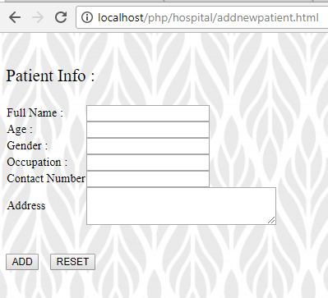
Patient registration

Slide 20
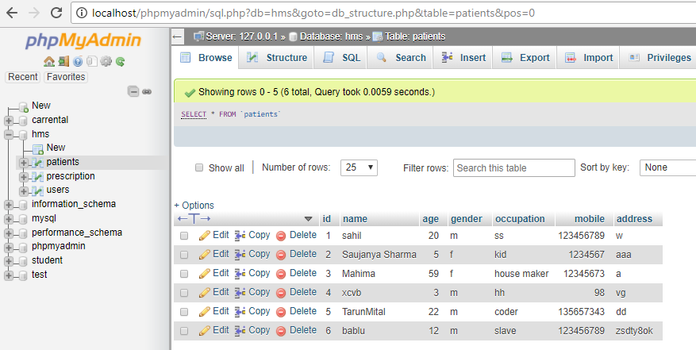
Patient database

Slide 21
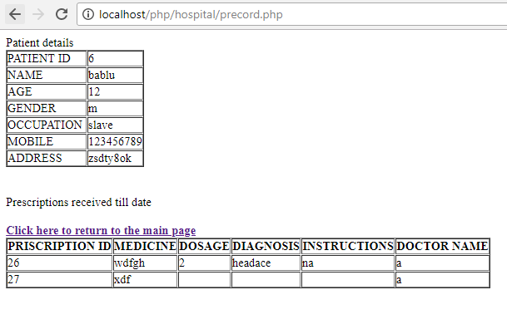
View patient details

Slide 22
The prescription
The prescription generation is a big part of the project where the doctors give the patients specialised prescriptions. In his we access all the data bases in which we access the patients details and using the session we get the doctor details.
Using accessing the details, the information is stored in the prescription databse.

Slide 23
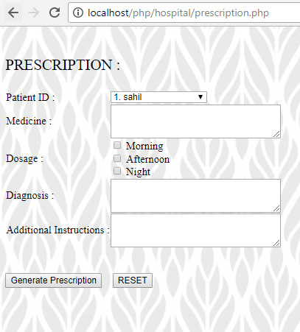
Prescription maker

Slide 24
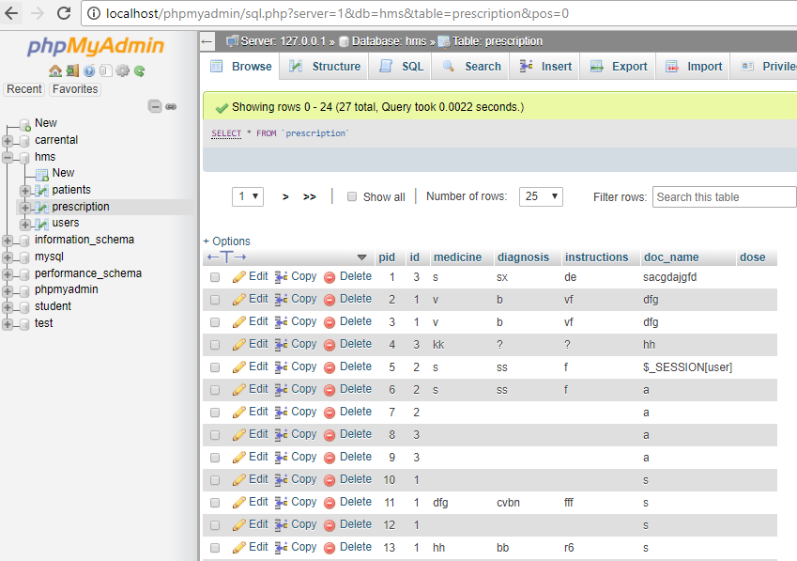
Prescription database

